Slide 1
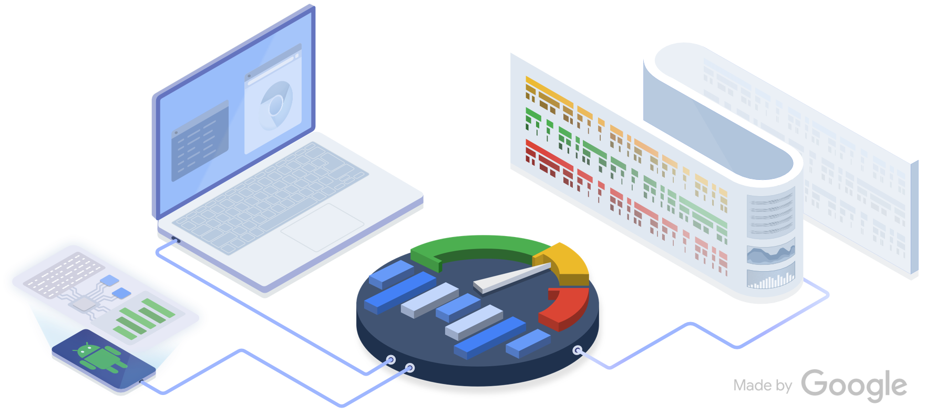
Perfetto - State of the union
Oct 11th, 2022 - Tracing Summit
primiano@google.com

Slide 2
Hi there!
primiano@, 9.5y in Google
2013: Joined Google, worked on Chrome/Webview crash reporting
2014-2017: chrome://tracing and Chrome-for-Android perf
2018: Started Perfetto together with Chrome folks
2019-today: Lead Android System Health Telemetry

Slide 3
Agenda
What is Perfetto 5 min
Recording traces (demo) 5 min
Trace Processor 2 min
Tracing SDK (demo) 5 min
What's next 2 min
If time allows…
Tracing at scale - case studies
Jank 5 min
CPU Profiling 3 min

Slide 4
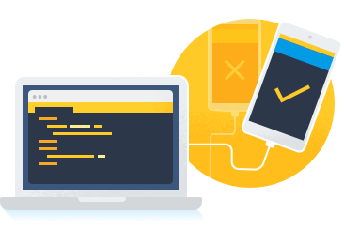
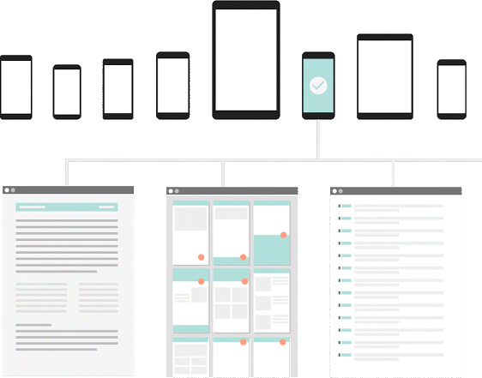
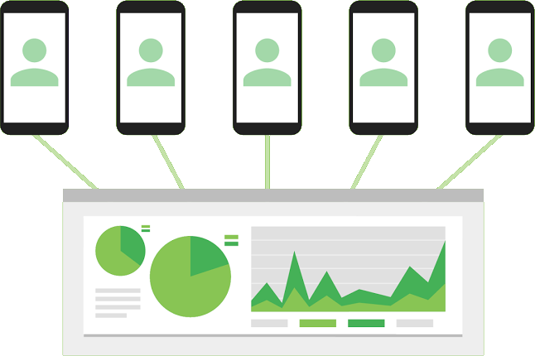
Perfetto: system-wide tracing+profiling (Linux-based) & in-app tracing (Win,Mac,Linux-based)
Local debugging
Lab testing
Dynamic field tracing
1
2
3
Trace-based metrics
Integration w/ dashboards and alerting
Traces captured when "problematic" events occur
Hard-to-repro issues that happen only in the field
Device bringup
Local investigations
Code yellows
Notes:
different tools…. why centralizing

Slide 5
What is Perfetto about?
Record traces
Platform probes
Android / CrOS / Linux
ftrace
/proc pollers
perf_ event
Heap Profiler
Android HALs
Tracing service
Android / Linux / CrOS / MacOS / Windows
Tracing SDK
Android / Linux / CrOS / MacOS / Windows
Trace Protocol
UNIX socket + shmem
Analyze traces
Protobuf-based trace format
Legacy formats (JSON, systrace, ...)
Perfetto Trace Processor Android / Linux / CrOS / MacOS / Windows
SQL Query engine
Trace tables
data model
Trace-based
metrics
SQLite
Visualize traces
Perfetto UI (web based, fully offline)
Android GPU Inspector
Android Studio
Notes:
Record traces:
A cross-platform tracing library for app instrumentation
A kernel + userspace tracing system tuned for client platforms (Android OS, Chrome Browser, ChromeOS)
A set of data probes deeply integrated with OS internals and browser internals
Analyze:
A C++ library to ingest various trace formats
A SQL interface to access the trace data
A rich set of domain-specific, opinionated, trace-based metrics (think reverse engineering the OS states from trace events)
Visualize:
A web-based fully-offline frontend to visualize traces

Slide 6
Why are we here?
We want to improve the user experience, specifically System Health
(System Health = performance + energy efficiency + stability)
It's the nature of the business. Great experience → happy users → more Google devices → Profit!
We have a huge social responsibility Android is the computing device for 3 B users who trust us. In many countries we are the only device people can afford. Efficient SW → cheaper HW → more people can afford tech → more people get a window on the world and better chances in life.

Slide 7
What's special about client platforms
Variable workload, high dynamic range of power & mem bandwidth
The workload is extremely variable and user-driven. Hard to have baselines expectations.
Most of the user-visible issues are about "several processes / sw layers trying to meet a 16ms/8ms deadline".
Android, Chrome and CrOS are special in so many different ways tech-wise
Custom libc, apps fork() from zygote, pid & uid, namespaces, syscall sandboxes, custom IPCs, SELinux, VMs.
Chrome (browser) needs to support all major OSes (Android, Linux/CrOS, MacOS, Win).
Versioning & ABI stability
Chrome releases every 6w, Android once/year, Android kernel & HAL even slower. We want to trace'em all.
Getting data out of devices
It's complicated (privacy and data budget) but solvable. Key reason why Perfetto is so much based on protos.
Security model
Want to trace everything, but that exposes tracing services to untrusted apps. Can't really CAP_SYS_ADMIN.
Overhead
CPU overhead doesn't matter as much as people think*, binary size and memory do way more.

Slide 8
Recording traces
A view of some Perfetto core platform probes

Slide 9
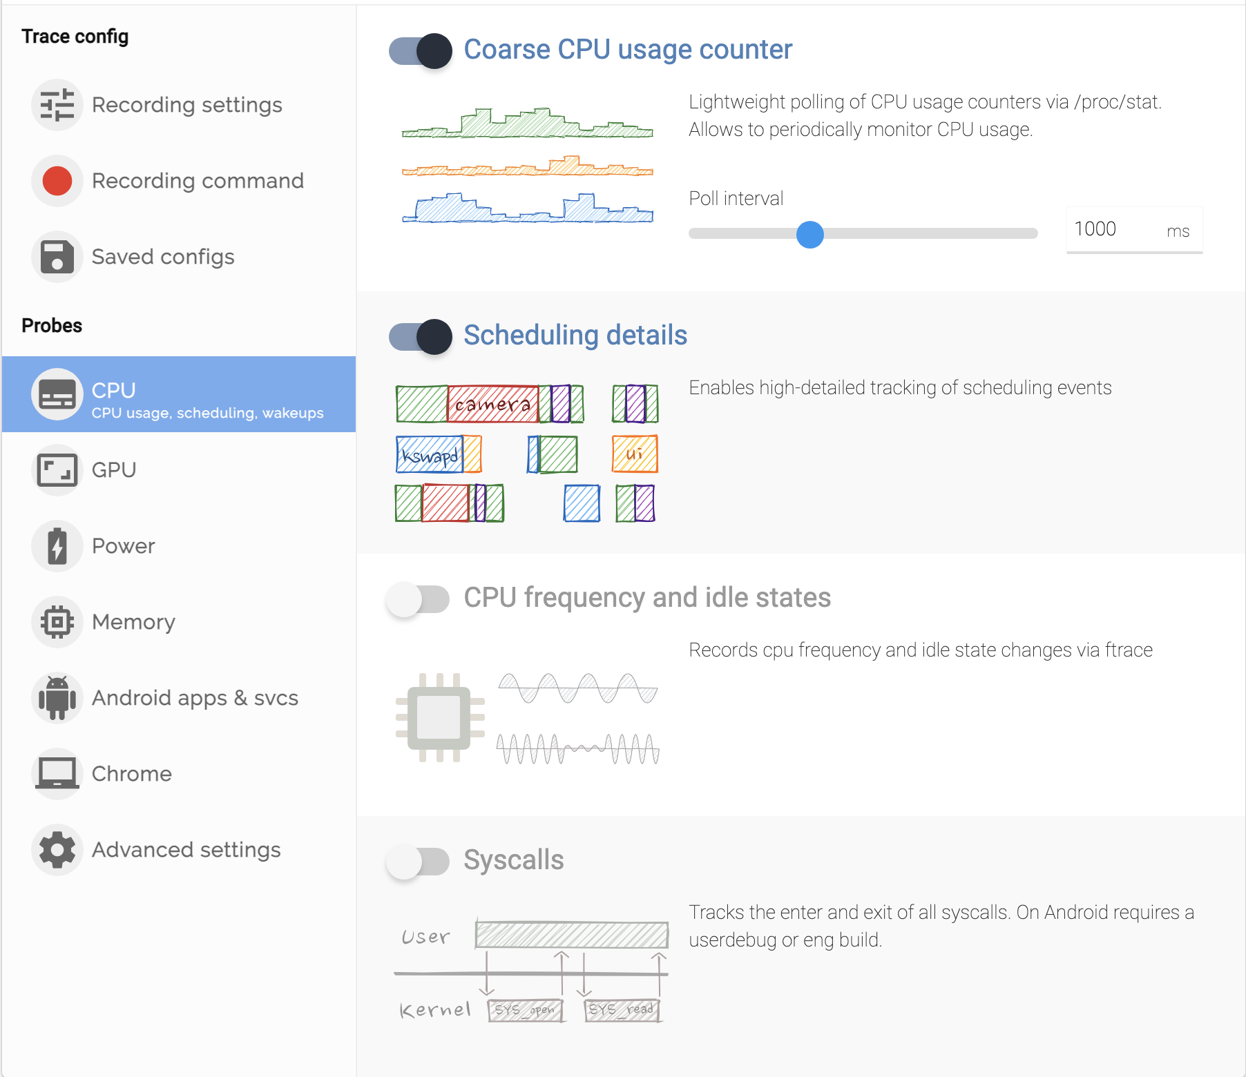
Recording a trace
1
Via ui.perfetto.dev

Slide 10
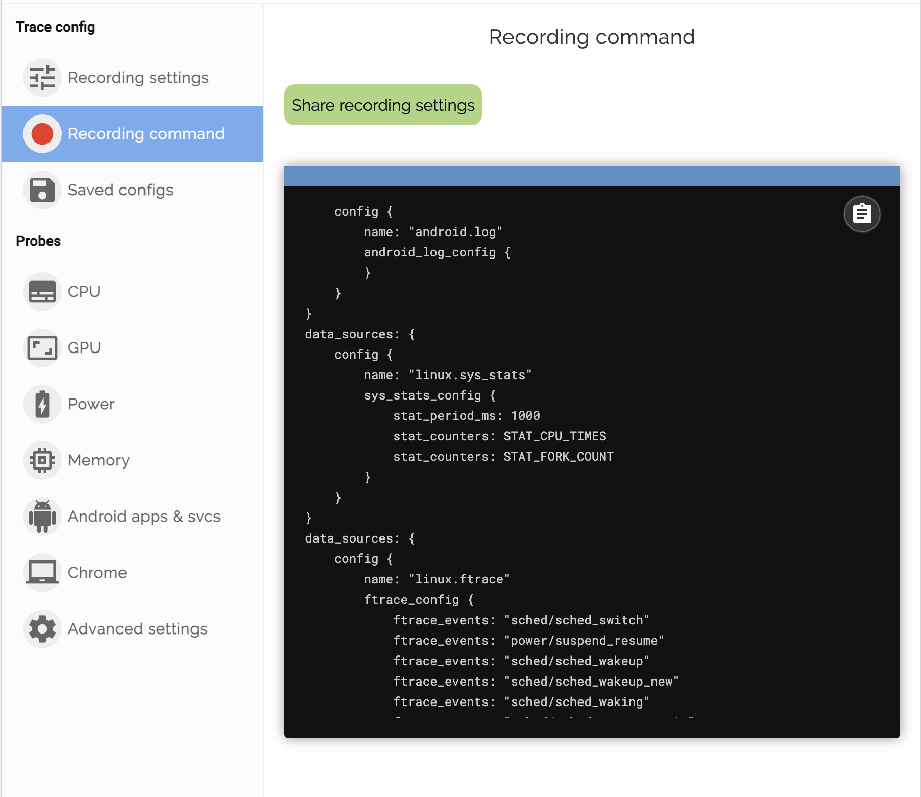
Recording a trace
1
Via ui.perfetto.dev

Slide 11
# Option 1: Or use helper scripts
tools/record_android_trace
tools/cpu_profile
tools/heap_profile
tools/java_heap_dump
# Option 2: pass a full trace config
perfetto -o out.pftrace -c config.cfg
Recording a trace
2
Via cmdline

Slide 12
subscription {
name: "PERFETTO_TRIGGER_SYSTEM_SERVER_MEMORY_TRACE_R"
description: "Trigger heap profiling when System server hits high RSS."
rule_type: ALERT
rule_name: "EXCESSIVE_SYSTEM_SERVER_MEMORY_USAGE_R"
perfetto_details {
trace_config: {
compression_type: COMPRESSION_TYPE_DEFLATE
buffers {
size_kb: 512
fill_policy: DISCARD
}
buffers {
size_kb: 7168
}
data_sources {
config {
name: "android.heapprofd"
target_buffer: 1
heapprofd_config {
sampling_interval_bytes: 65536
process_cmdline: "system_server"
# Only trigger for processes that have exceeded
# threshold
no_startup: true
# Introduced in S (no effect in previous versions)
adaptive_sampling_shmem_threshold: 4194304
adaptive_sampling_max_sampling_interval_bytes: 524288
target_installed_by: "@system"
target_installed_by: "com.android.vending"
Recording a trace
3
Unmanned!
Automatically capture traces* when known perf issues are detected!
* From Google employees' phones
Notes:
TODO pitot link at this point to memory and jank

Slide 13
Analyzing traces
Perfetto Trace Processor

Slide 14
Trace Processor
Portable C++ library. A SQL engine for trace analysis.
One trace file
Custom SQL queries
pre-baked metrics
or
Efficient
Can ingest multi-GB / hours-long traces
SQL-powered
Based on industry standard SQLite engine
Interoperable
Runs on servers! Runs on Android! Runs in the browser (via Web Assembly)! Runs in other IDEs and tools.
Easy to embed in other apps and integrate with ad-hoc perf test infrastructure
Perfetto Trace Processor
CSV
JSON
Protobuf
See Lalit's talk on Wed 12th!
Notes:
A C++ library that is able to ingest traces of various formats and expose them to be queried using SQL.
It can quickly ingest very large traces
Sql based as you can see on the right this is how you would write a query to extract some information from the trace,
in this case ...
The trace process is easy to embed in other apps and so can be used everywhere which ensures a consistent experience in all it’s different uses.

Slide 15
# CPU time for top 100 processes
# broken down by cpu
SELECT
thread.name as thread_name,
tid,
cpu_sec
FROM
(SELECT
utid, SUM(dur)/1e9 as cpu_sec
FROM
sched
GROUP BY utid
ORDER BY dur DESC
LIMIT 100
)
INNER JOIN thread USING(utid)
thread_name tid cpu_sec
-------------------- -------------------- --------------------
swapper/0 0 167.479572
Binder:1191_11 2885 2.957067
Binder:1191_4 1583 2.831097
kswapd0 150 2.227615
traced_probes 896 2.024229
roid.apps.inbox 7535 1.780714
RenderThread 7584 1.727868
Binder:1191_19 6095 1.640379
One trace file
Custom SQL queries
pre-baked metrics
or
Perfetto Trace Processor
CSV
JSON
Protobuf
See Lalit's talk on Wed 12th!
Notes:
A C++ library that is able to ingest traces of various formats and expose them to be queried using SQL.
It can quickly ingest very large traces
Sql based as you can see on the right this is how you would write a query to extract some information from the trace,
in this case ...
The trace process is easy to embed in other apps and so can be used everywhere which ensures a consistent experience in all it’s different uses.

Slide 16
Slide courtesy of Microsoft

Slide 17
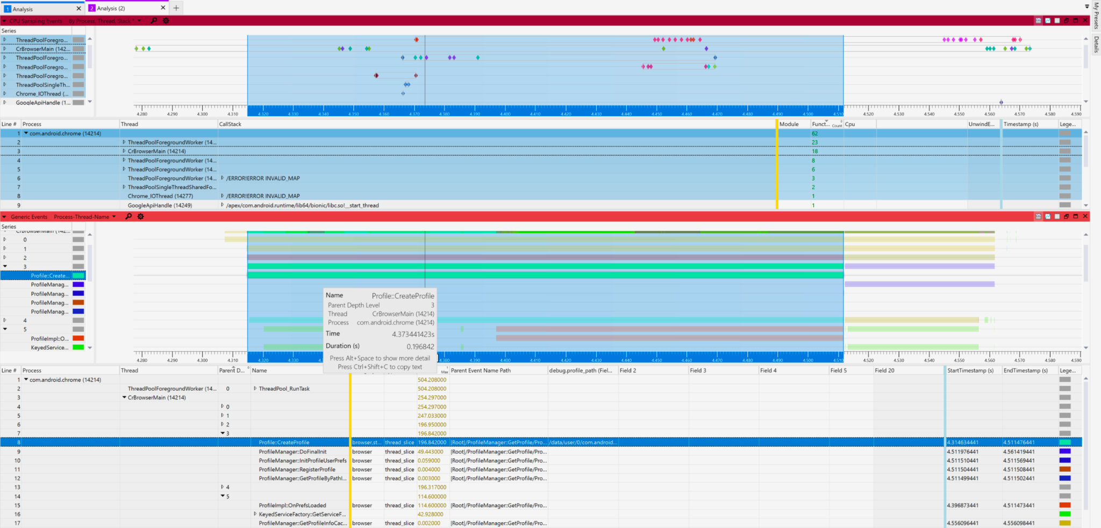
https://devblogs.microsoft.com/performance-diagnostics/perfetto-tooling-for-analyzing-android-linux-and-chromium-browser-performance-microsoft-performance-tools-linux-android/

Slide 18
Tracing SDK
For direct userspace-to-userspace tracing on client OSes

Slide 19
I wrote an HTTP server last night
Let's trace it together!

Slide 20
#include "perfetto/tracing.h"
// The set of track event categories that the example is using.
PERFETTO_DEFINE_CATEGORIES( //
perfetto::Category("net"), // For tracing network operations.
perfetto::Category("io"), // For tracing I/O.
perfetto::Category("dbg").SetTags("debug"), //
);
PERFETTO_TRACK_EVENT_STATIC_STORAGE();

Slide 21
void Main(int argc, char** argv) {
CreateListeningSocket(); // Does socket() + bind() + listen().
for (int conns = 0;; conns++) {
int fd = accept(g_listening_sock.fd(), nullptr, nullptr);
if (fd < 0)
break;
// Spawn a thread for each connection, like the pros!
std::thread worker_thd(&SocketThread, fd);
worker_thd.detach();
TRACE_EVENT_INSTANT("net", "New connection");
TRACE_COUNTER("net", "Connections accepted", conns);
} // for (...) accept() loop
if (trace)
StopTracing(std::move(trace));

Slide 22
void SocketThread(int fd) {
TRACE_EVENT("net", "SocketThread"); // Scoped / RAII instrumentation point.
UnixSocketRaw sock(ScopedSocketHandle(fd), SockFamily::kInet, SockType::kStream);
// By default events are tied to the "current thread track".
TRACE_EVENT_BEGIN("net", "Receive()");
char buf[1024]{};
auto rsize = sock.Receive(buf, sizeof(buf) - 1);
buf[rsize > 0 ? rsize : 0] = '\0';
TRACE_EVENT_END("net");
// HTTP protocol parsing with string split, like the pros!
auto parts = SplitString(buf, " ");
const auto& uri = parts.size() > 1 ? parts[1] : "?";
std::string response;
std::string code = "200 OK";
// This creates an event in a global track (the UI will merge them by name).
auto event_id = perfetto::Track::Global(static_cast<uint64_t>(12345678 + fd));
TRACE_EVENT_BEGIN("net", "HTTP Requests", event_id, /*args*/ "uri", uri,
"pid", static_cast<int>(GetProcessId()));

Slide 23
void SocketThread(int fd) {
...
TRACE_EVENT_BEGIN("net", "Send()");
sock.Send(http_resp.data(), http_resp.size());
TRACE_EVENT_END("net");
sock.Shutdown();
TRACE_COUNTER("net", "Response Size", http_resp.size());
TRACE_COUNTER("net", "Total Bytes Served",
total_bytes_served.fetch_add(http_resp.size()));
// For more complex cases one can get a proto writer interface and directly
// fill a protobuf.
TRACE_EVENT_INSTANT("dbg", "histogramz", [](perfetto::EventContext ctx) {
auto* hist = ctx.event()->set_chrome_histogram_sample();
hist->set_name("HistogramName");
hist->set_sample(42);
});

Slide 24
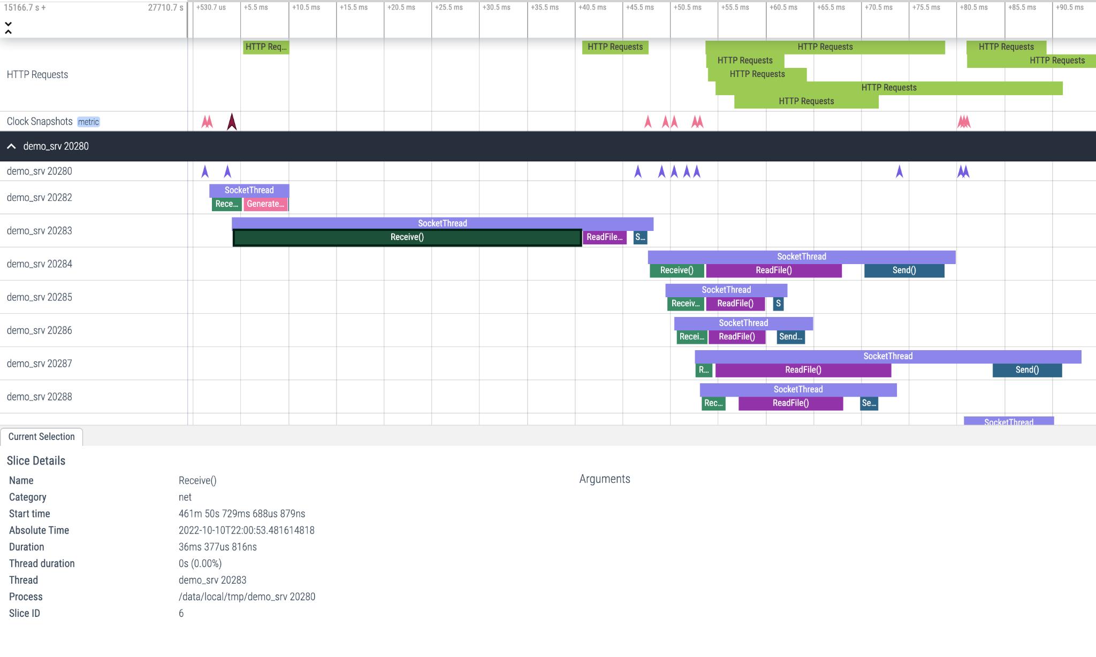

Slide 25
What's next in Perfetto

Slide 26
What's next - key highlights
1. Tracing SDK
Today: it's big (binary size wise); it's C++ only; it's static-link only
But… we are fixing all this, with a stable API+ABI + shared lib for Linux & Android
See bit.ly/perfetto-c for more details
2. Perfetto UI (ui.perfetto.dev)
Today: all codebase and features are maintained by 2-3 people, doesn't scale.
Next: modularize the UI, create a component API, allow people to create their own plugins and provide custom visualization widgets, tracks, details panels.
3. Batch Trace analysis
Lot of cool parallel-processing of traces integrated with Python. See Lalit's talk.

Slide 27
Tracing at scale
From real world devices

Slide 28
Android Approach to perf up to ~2019
Where this breaks down
What if you can't reproduce the bug?
What if the bug you are seeing is an unrelated outlier?
Is this impacting 0.001% or 10% of users?
How can you convince a team to prioritize fixes?
Grab a phone
Capture a trace which contains a bad behaviour
Figure out what's the cause of the bad behaviour
Build a hypothesis, attempt a fix, and grab another trace to confirm the fix.

Slide 29
"There are more performance problems out there than anybody can solve "
John, performance engineer - 25 years old
Notes:
Why invested into the analytics and not just the tracing tool.
What I want to do in this talk is convincing you that is not just about tools and solving problems, it's about methodology, analysis and scale

Slide 30
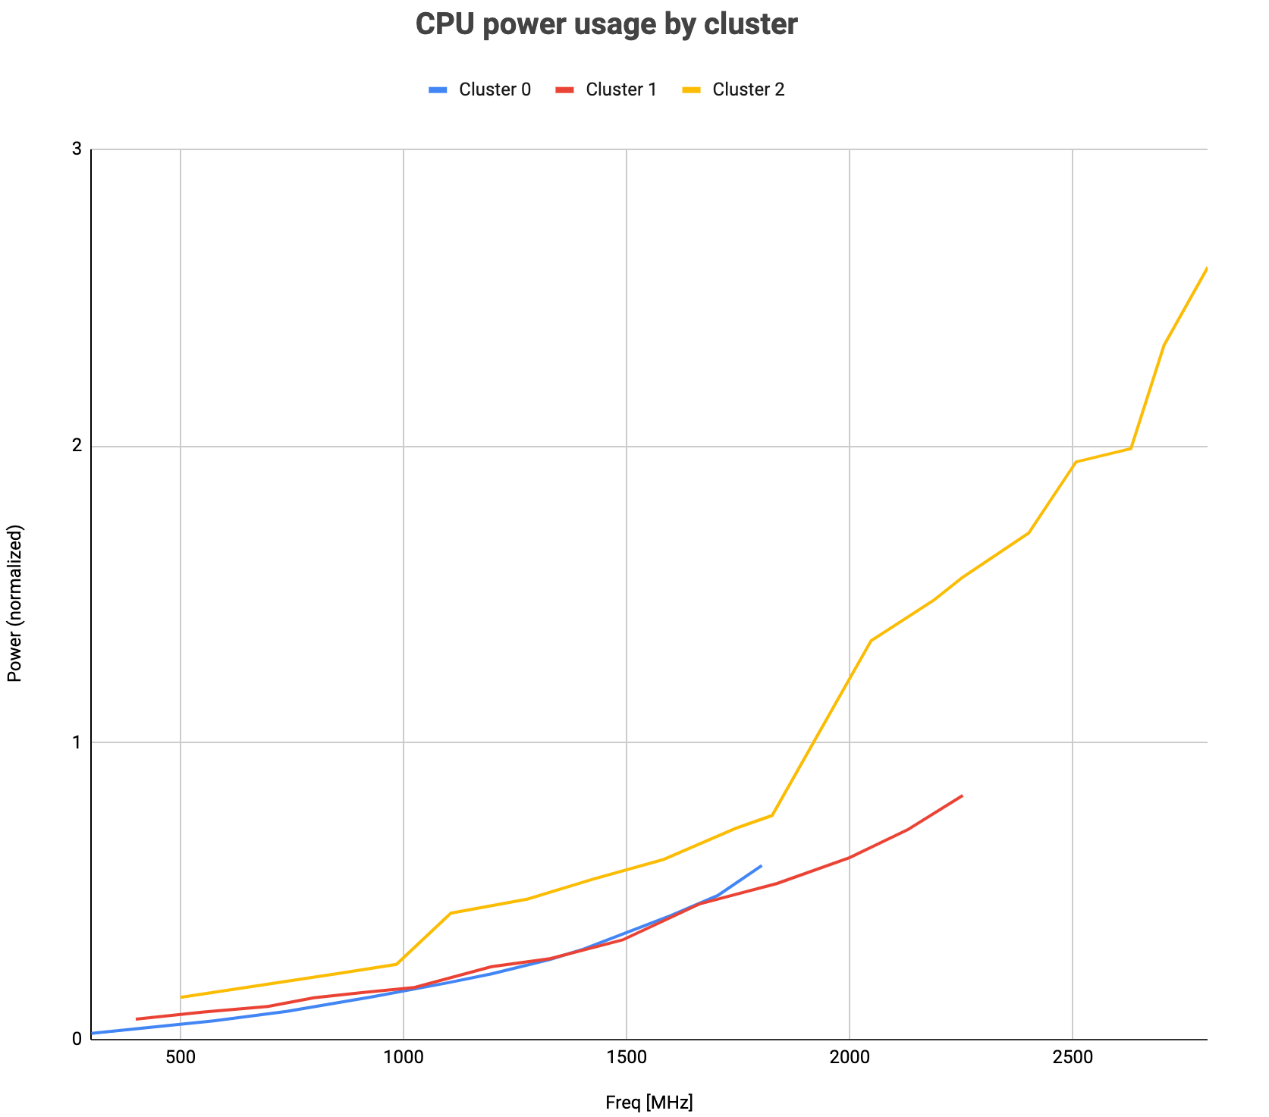
4.5x between clusters at their max freq
~45x dynamic range
~10x between min/max on the little cluster
Notes:
Mobile is very different from the server world, mindset is different

Slide 31
Case study: Jank
(choppy and/or unresponsive UI interactions)

Slide 32
Animation Jank metrics
Until 2020 Android didn't have good Jank metrics.
"good" := representative of what the user experiences.
Let's look at the life of a frame

Slide 33
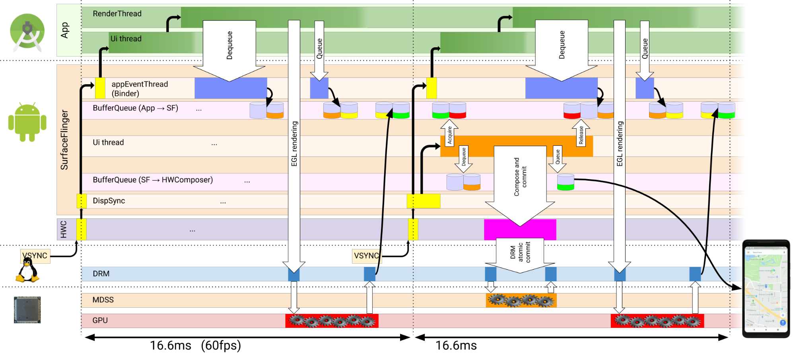
Journey of an Android frame
From https://lwn.net/Articles/809545/, courtesy of balsini@

Slide 34
Journey of an Android frame (simplified)
Let's look at the life of a frame → It's a pipeline (a complicated one)
Just the "metric" part took several SWEs x ~3-6 months
For more see perfetto.dev/docs/data-sources/frametimeline
This is really what users see!

Slide 35
What can go wrong? So many things
Scheduling issues in any IPC across the various threads involved
lock contentions
priority inversions
little-core affinity at the wrong time
I/O makes everything 10x slower
The compositor's internal state machine can get into bad states
Too much work on the main thread
Too much work on the render thread
IPC (binder) transactions on key threads took too long
JIT at the wrong time
GC at the wrong time
…
Many many others

Slide 36
Jank approach in one slide
Break down the problem space
In Critical User Journeys
App Launch
Metrics
Measure Jank
Measure what users see
Switch app
…
Open app launcher
Action
Fix top issues
Profit!
Trigger trace collection
When jank happens
Analyze traces Observe root causes, lot of manual work!
Scale up!
Write trace classifiers, run them against the corpus
Stack rank
GROUP BY root cause,
ORDER BY COUNT()

Slide 37
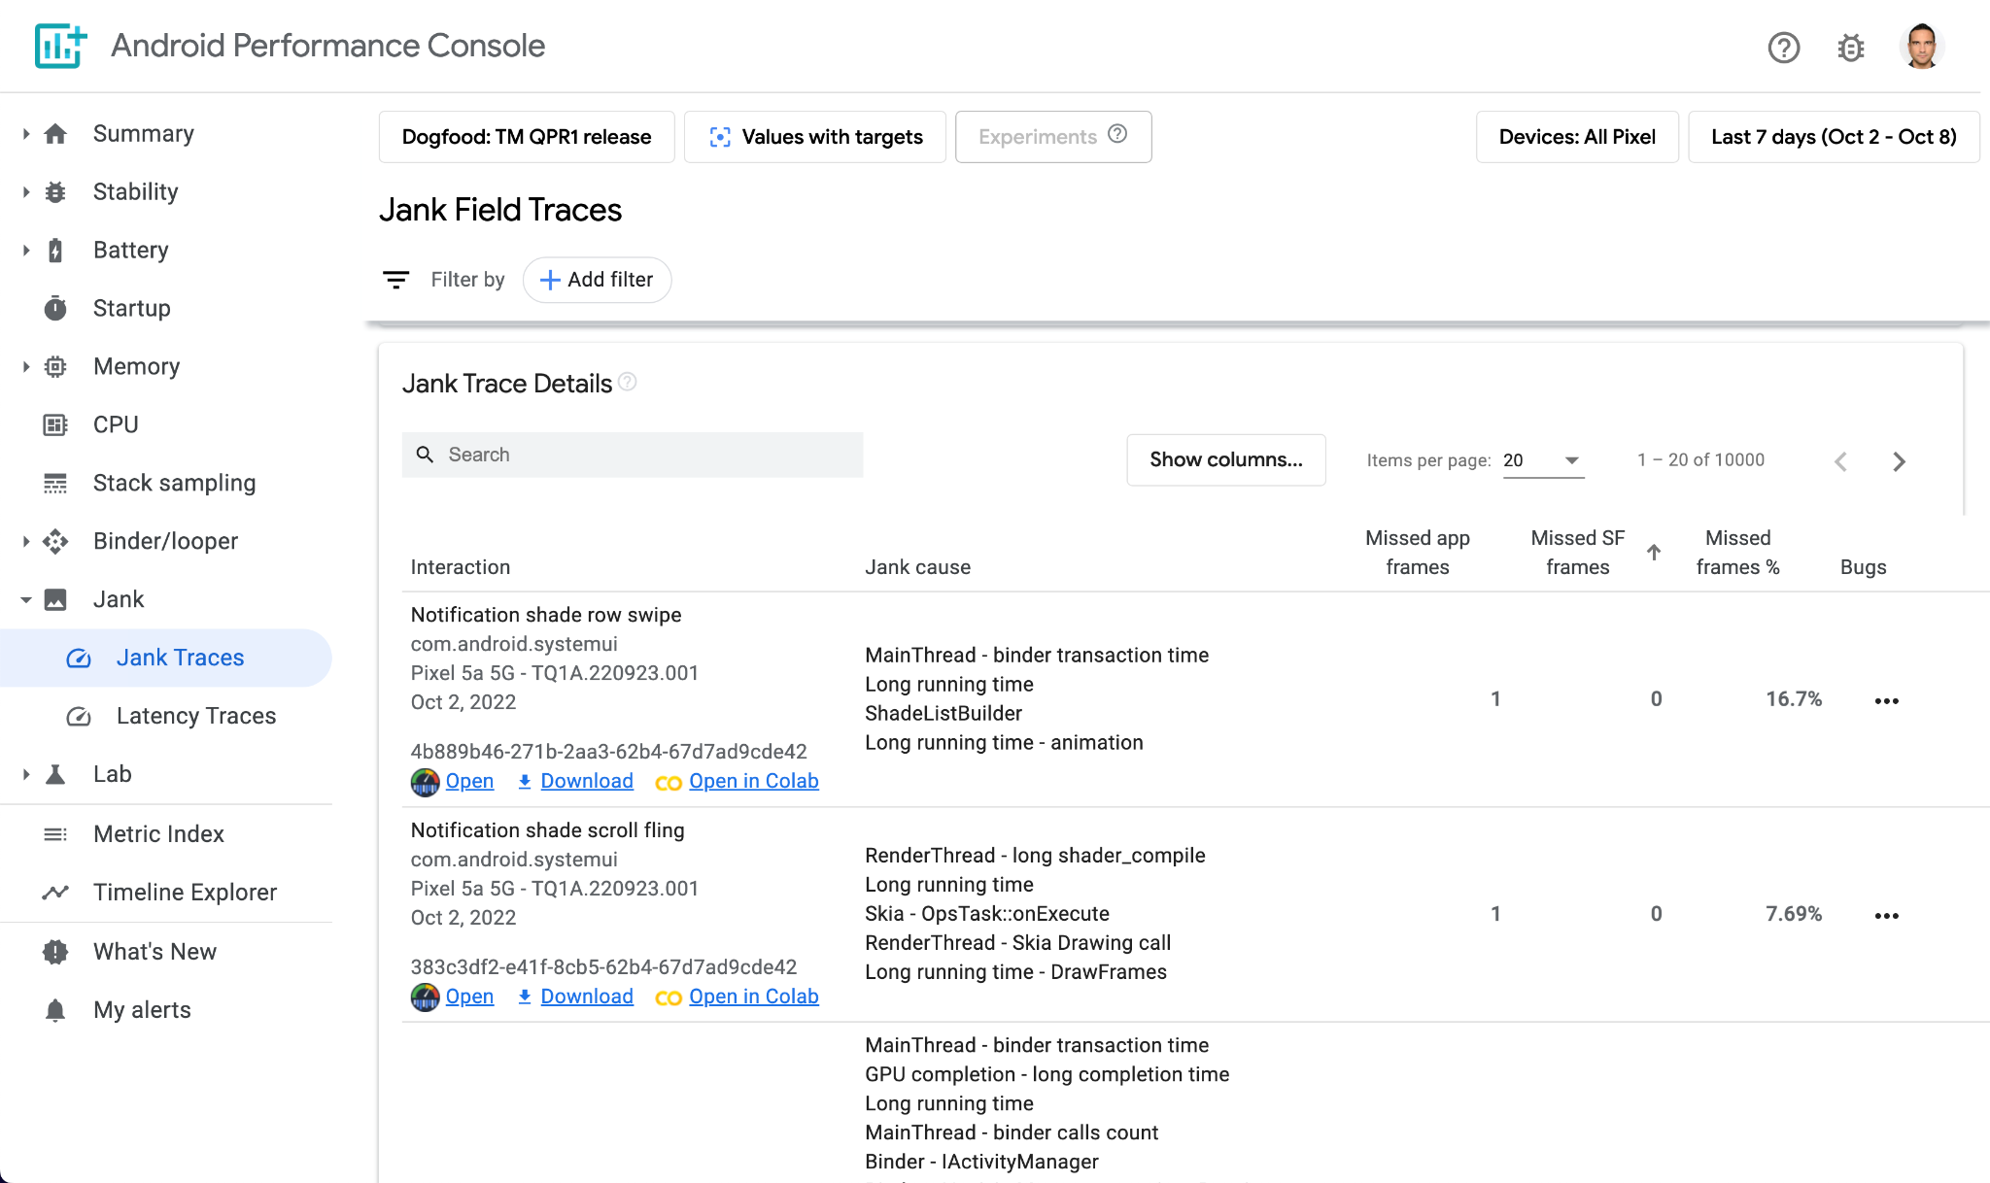

Slide 38
Each row like this is a trace

Slide 39
Each line is a root cause
which some brave humans identified and wrote a classifier for in SQL

Slide 40
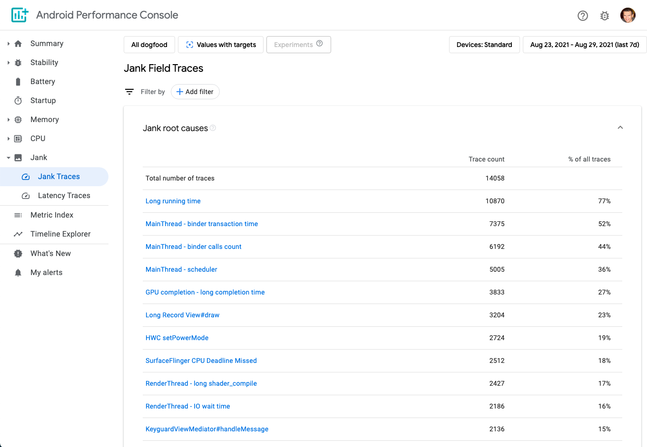
Notes:
https://pitot.corp.google.com/u/0/jank/jank_traces?device_view=1.sailfish,1.marlin,1.walleye,1.taimen,1.blueline,1.crosshatch,1.sargo,1.bonito,1.flame,1.sunfish,1.bramble,1.coral,1.redfin,1.barbet&release=dogfood-all&comparison=target&start=20210823&end=20210829

Slide 41
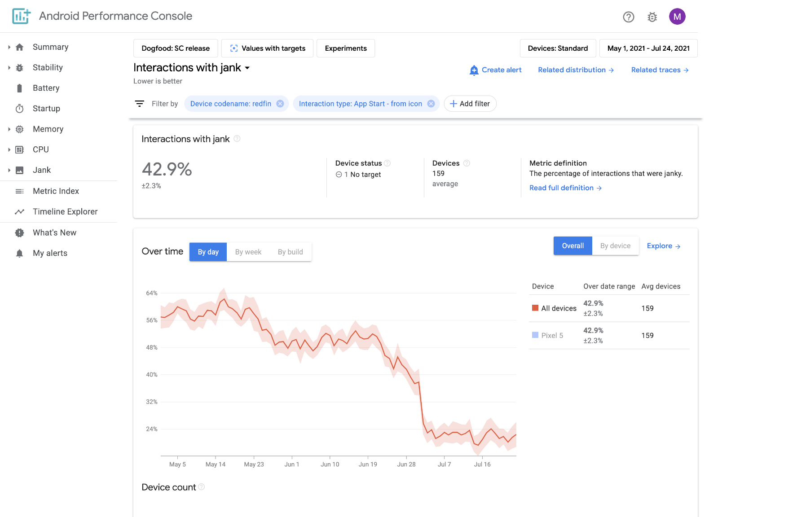
App start from icon
58% -> 21 %

Slide 42
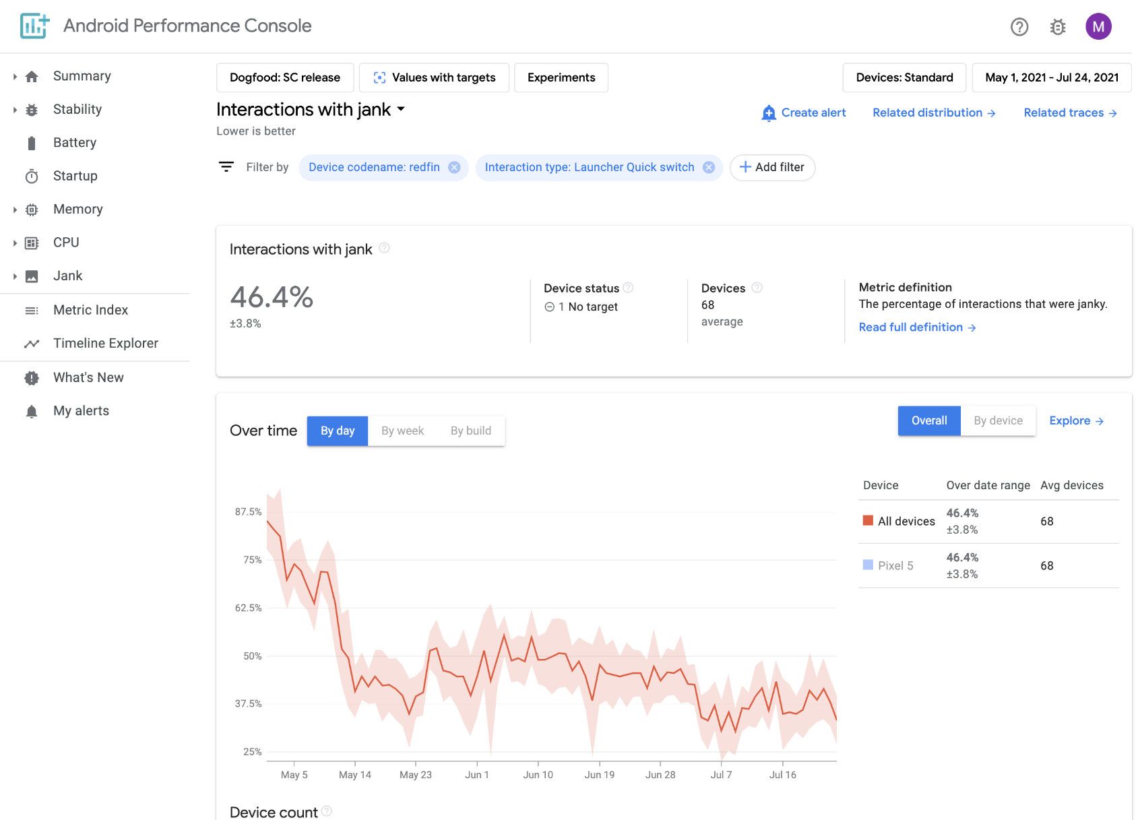
Launcher quick switch
85% -> 38%

Slide 44
Callstack Sampling

Slide 45
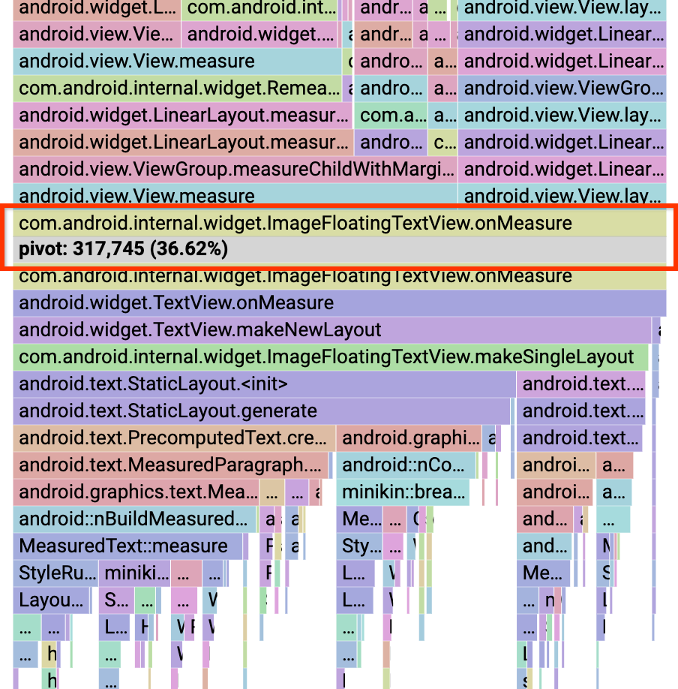
Security
Unwinding
Symbolization
Deobfuscation
APC
Perfetto traced_perf traces
Perfetto traced_perf traces
Perfetto traced_perf traces

Slide 46
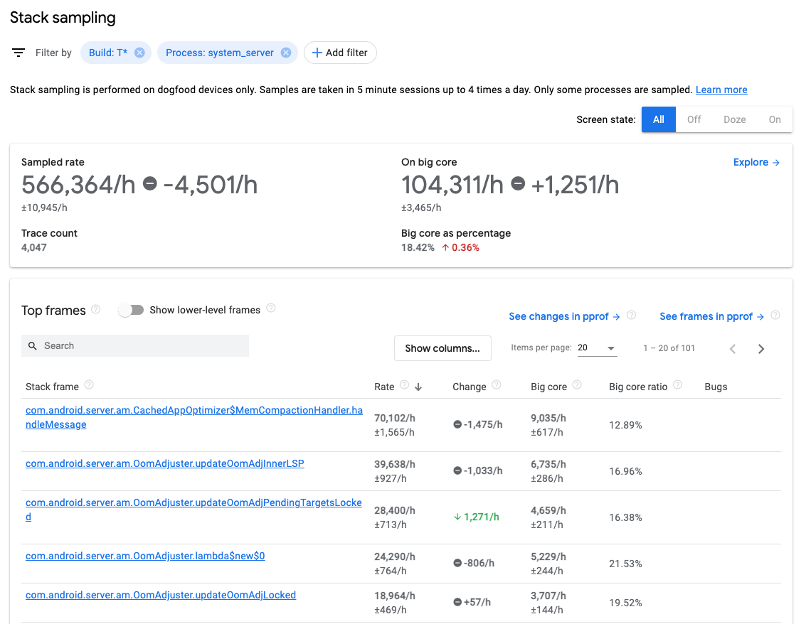

Slide 47
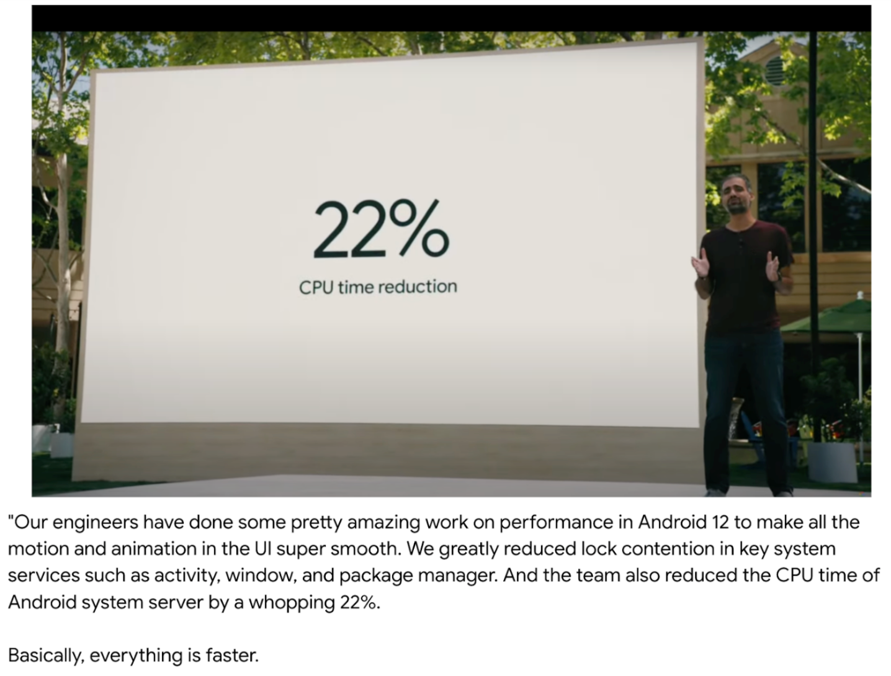
As soon as you look, you find…
Started looking at system server ~1 year ago
4% CPU looking up device WiFi capabilities.
8% collecting battery use stats.
With bonus massive lock contention!
Endless over-eager logging code.
Many many more.

Slide 48
"What if "time"
was not
the sampling timebase"

Slide 49
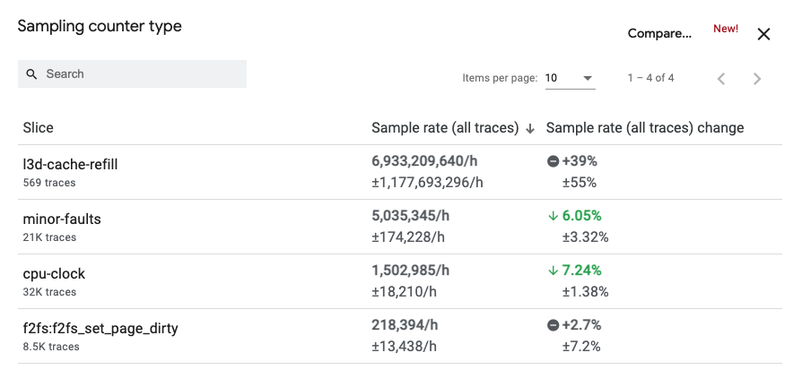

Slide 50
"What if we kept context into account?"

Slide 51
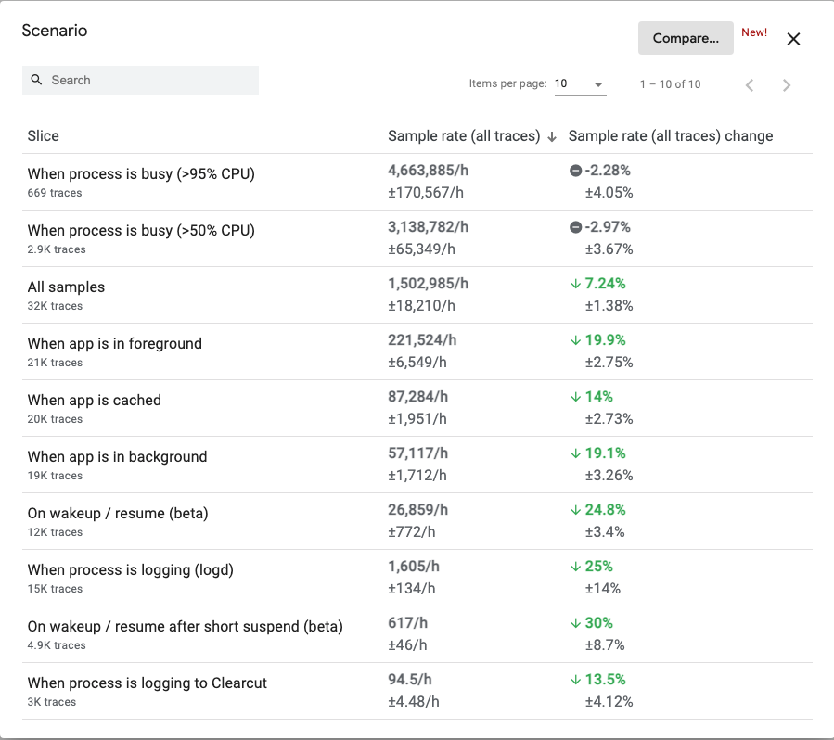

Slide 52
Fixing 3P app slowness
REDACTED was the slowest large app for years in terms of cold startup time
Distribution of start time was bimodal–that's weird!
Got slow traces from droidfood: the slow cases all waited for a lock in the app and eventually timed out after 1.5s
Almost certainly an app bug
Spoke to their devs for half an hour on a Wednesday at 4pm
Friday at 10am: "we found the bug and fixed it"
REDACTED startup is fine now

Slide 53
Takeaways of field tracing
Metrics first. You can't optimize what you can't measure
Figure out what data you want! There is no universal trace
Come up with the appropriate event to trigger collection
Dump traces or sample those events accordingly
Saves a ton of time trying to reproduce bugs
No questions about whether the data is realistic
Helps enable other teams to prioritize perf work

Slide 54
Thanks! Questions?
For docs, mailing list and discord channel see
perfetto.dev

Slide 55
Random bonus slides beyond this point

Slide 56
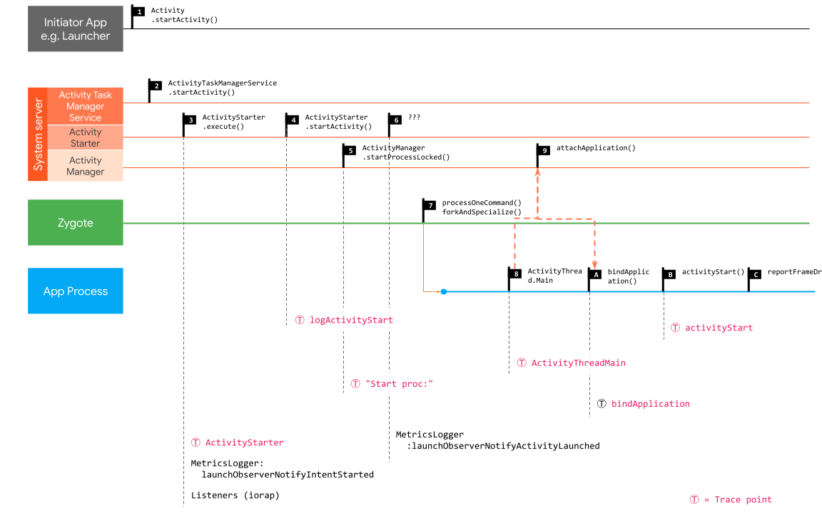
Journey of an Android cold start
From a 2019 study go/startup-metrics. Most of this changed substantially in the last 2 years.

Slide 57
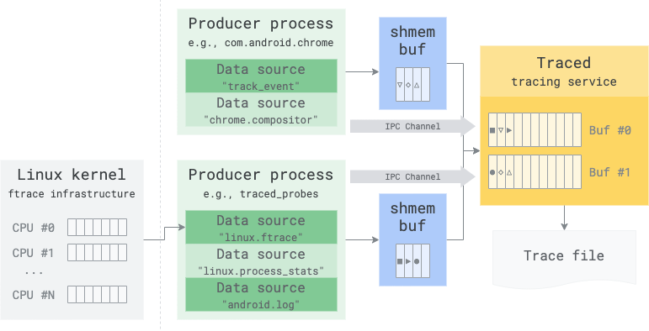

Slide 58
In-process vs system-mode tracing
In process tracing
(when I passed --trace in the demo)
System-mode tracing
(when I passed --ext in the demo)
Process
/proc/pid/*/status
KERNEL
ftrace
Thread 1
Thread N
/proc/meminfo
/proc/vmstat
/proc/stat
...
TRACE_EVENT(...)
...
TRACE_EVENT(...)
...
Process 1
traced_probes [process]
Tracing service thread
USERSPACE
Perfetto SDK
trace buffers, coordination ...
...
traced
[process]
Process N
Perfetto SDK

Slide 59
Tracing configuration language
It's a proto (mild shock)!
Might seem overkill right now but... wait for field tracing.
See the web configurator @ https://ui.perfetto.dev/#!/record/instructions
buffers: {
size_kb: 65536
}
data_sources: {
target_buffer: 0
config {
name: "track_event"
}
}

Slide 60
Tracing SDK example
int main() {
perfetto::TracingInitArgs args;
args.backends = perfetto::kSystemBackend;
perfetto::Tracing::Initialize(args);
// DataSourceDescriptor can be used to advertise app-specific features.
perfetto::DataSourceDescriptor dsd;
dsd.set_name("com.example.my.data.source");
dsd.add_available_counters("n_dropped_frames");
MyDataSource::Register(dsd);

Slide 61
System tracing demo
adb shell -t perfetto -c /data/misc/perfetto-configs/systrace.cfg --txt -o /data/misc/perfetto-traces/trace
./traceconv profile ~/Downloads/trace

Slide 62
Tracing library in a nutshell
message TracePacket {
ProcessTree process_tree = 1;
...
BatteryCounters battery = 39;
}
message BatteryCounters {
// Battery capacity in microampere-hours(µAh).
int64 charge_counter_uah = 1;
// Remaining battery capacity percentage of total capacity
float capacity_percent = 2;
// Instantaneous battery current in microamperes(µA).
int64 current_ua = 3;
}

Slide 63
Tracing library in a nutshell
Process A
ProtoZero
Append-only protobuf encoder
Minimal subset of libprotobuf API
Zero-copy, zero-malloc, zero-syscall *
Directly serialize events into the tracing shmem buffer
* Until you reach the end of the page.
Thread 1
Page header
Page 1
FLD:1, V=10
FLD:2, V=100.0
FLD:3, V=1234
Page 1
Page 2
Page 3
Page 4
Tracing shmem buffer
auto evt = GetThreadLocalTraceWriter().BeginPacket<BatteryCounters>();
evt->set_charge_counter_uah(10);
evt->set_capacity_percent(100.0);
evt->set_current_ua(1234);

Slide 64
Tracing library in a nutshell
Process A
Thread 1
Page header
Page 1
Page 2
FLD:1, V=10
FLD:2, V=100.0
[mutex]
Tracing service
FLD:3, V=1234
Page 1
Page 2
...
Page 2
Page 3
Page 4
Page 2
Page 3
Page 4
...
Tracing shmem buffer
Per-process shmem
IPC
Process B
Page 1
Page 2
Page 3
Page 4
Page 1
Page 2
Page 3
Page 4
Trace buffer
NOT shared

Slide 65
New SQL constructs
Harmonization
Event 1
Event 2
Event 3
Event 4
Event 5
Event 6
Counter A
Counter B
E1
E2
E4
E5
CA
CA
CB
CB
CREATE VIRTUAL TABLE quantized USING span(sched, counters, cpu)
Docs: https://perfetto.dev/docs/analysis/trace-processor#operator-tables
Partition key

Slide 66
New SQL constructs
Quantization
Event 1
Event 2
Event 3
Event 4
Event 5
Event 6
Quantum
Quantum
Quantum
Quantum
...
Event 1
E2
E2
Event 3
E4
Event 4
Event5
E5
Event6
...
CREATE VIRTUAL TABLE bounds USING window;
UPDATE bounds SET quantum=... where 1
CREATE VIRTUAL TABLE quantized USING span(sched, bounds)
Docs: https://perfetto.dev/docs/analysis/trace-processor#operator-tables

Slide 67
New SQL constructs
Windowing
Event 1
Event 2
Event 3
Event 4
Event 5
Event 6
Window
Event 1
Event 2
Event 3
Event 4
CREATE VIRTUAL TABLE bounds USING window;
UPDATE bounds SET window_start=X, window_dur=Y where 1
CREATE VIRTUAL TABLE clipped USING span(sched, bounds)
Orig table
Clip mask
Docs: https://perfetto.dev/docs/analysis/trace-processor#operator-tables

